Slide 1

Compiler Design
Preet Kanwal
Department of Computer Science & Engineering
Teaching Assistant : Sree Pranavi G

Slide 2

Compiler Design
Unit 4: Code Optimization on CFG
Preet Kanwal
Department of Computer Science & Engineering

Slide 3
Compiler Design Lecture Overview
In this lecture, you will learn about -
Global Optimization on CFG

Slide 4
Compiler Design Optimization on CFG - Global optimization
ENTRY
m = 1
limit = 10
i = 0
if m==1 goto B2
B1
B2
B3
n = 2
n = 0
t1 = limit-n
if i < t1 goto B5
B5
B4
t2 =2*m x = t2
t3 = i + 1 i = t3 goto B4
EXIT

Slide 5
Compiler Design Optimization on CFG
Steps to optimizing CFG
In Block 1 , Since the value of m is known as 1, we can evaluate the condition:
if m==1 goto B2
making B3 unreachable and hence removing the B3 as it contains dead code.
Next we can move n = 2 in B2 to block B1 and remove B2.
Since value of limit and n is known we can propagate the value to B4, and constant fold the value t1 as 10 -2 = 8.
Next we can propagate the value of t1 to the statement:
if i < t1 goto B5 ➔ if i < 8 goto B5

Slide 6
Compiler Design Optimization on CFG
Steps to optimizing CFG
After this as t1 is not being used anywhere else, t1 = 8 becomes a dead code and hence can be eliminated.
In Block B5, we must draw the Dag and the optimized code using DAG is :
x = 2 * m i = i + 1 goto B4
Since x = 2 * m is loop invariant we move it to Block 1.
If required we can constant fold x by propagating the value of m, since x is not being used anywhere we can eliminate x = 2 * m.
Similarly in Block 1 we can eliminate the dead code :
limit = 10; m = 1, n = 2.

Slide 7
Compiler Design Optimization on CFG
Optimized CFG
ENTRY
i = 0
B1
if i<8 goto B5
B5
B4
B6
i = i+1 goto B4
print i
if we take into consideration loop unrolling, then Compiler will just keep block B6 and rest of the blocks will be removed
EXIT

Slide 8
Compiler Design Optimization on CFG
Example 2
for (i = 0; i<n; i++) { for (j=0; j<n; j++){
if (i%2){
P[i][j] = 10*j + 5*i; Q[i][j] = 10 + 10*j;
}
}
}
//print(array P);
//print (array Q);

Slide 9
Compiler Design Optimization on CFG
Example 2 - Questions
Which one of the following is false?
The code contains loop invariant computation
There is scope of common sub-expression elimination in this code
There is scope of strength reduction in this code
There is scope of dead code elimination in this code
Justify each statement which is true with proper explanation,

Slide 10
Compiler Design Optimization on CFG
Example 2 - Solution
5 * i and i % 2can be moved out of the inner loop - loop invariant computations, hence (a) is true.
10 * j is a candidate for common sub expression elimination hence (b) is true.
10*j can be replaced with t1 = -10 before the j loop and place
t1 = t1 + 10 wherever 10 * j is being computed. Similarly for 5 * i. Hence ( c) is true as there is a scope for strength reduction in this code.
No dead code present in the given piece of code, hence (d) is false.

Slide 11
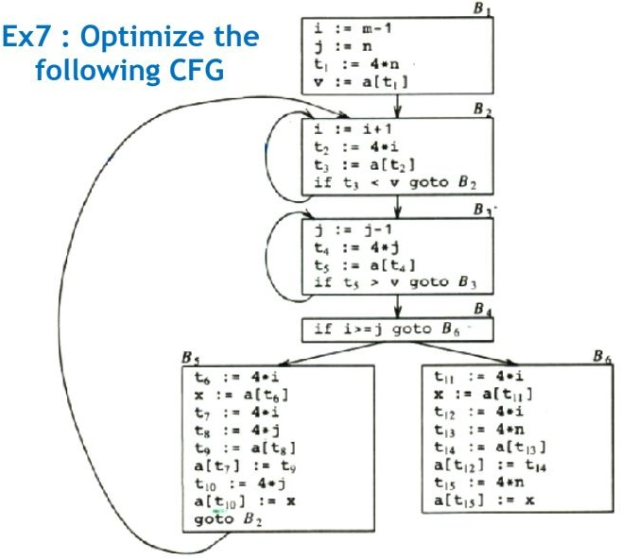
Compiler Design Optimization on CFG
Example 3

Slide 12
Compiler Design Optimization on CFG
Example 3 contd.
Block B5
t6 = 4 * i x = a[t6] t7 = 4 * i t8 = 4 * j t9 = a[t8] a[t7] = t9 t10 = 4 * j a[t10] = x goto B2
Local optimization within the block

Slide 13
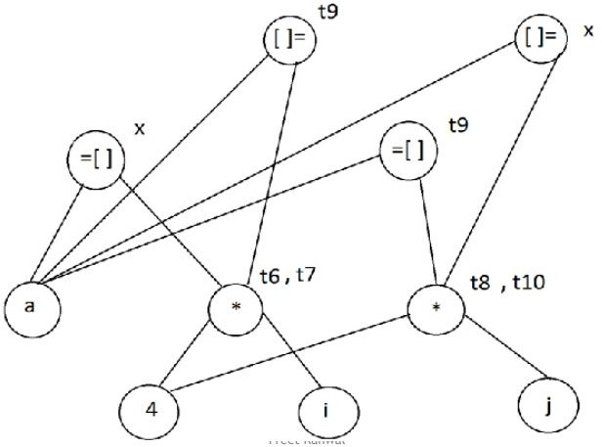
Compiler Design Optimization on CFG
Example 3 contd.
DAG
Block B5
t6 = 4 * i x = a[t6] t7 = 4 * i t8 = 4 * j t9 = a[t8] a[t7] = t9 t10 = 4 * j a[t10] = x goto B2
t6 = 4 * i x = a[t6] t8 = 4 * j t9 = a[t8] a[t6] = t9 a[t8] = x goto B2

Slide 14
Compiler Design Optimization on CFG
Example 3 contd.
Block B6
t11 = 4 * i x = a[t11] t12 = 4 * i t13 = 4 * n
t14 = a[t13] a[t12] = t14 t15 = 4 * n a[t15] = x

Slide 15
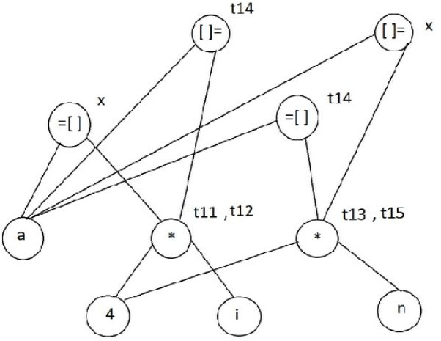
Compiler Design Optimization on CFG
Example 3 contd.
DAG
t11 = 4 * i x = a[t11] t13 = 4 * n
t14 = a[t13] a[t11] = t14 a[t13] = x
t11 = 4 * i x = a[t11] t12 = 4 * i t13 = 4 * n
t14 = a[t13] a[t12] = t14 t15 = 4 * n a[t15] = x

Slide 16
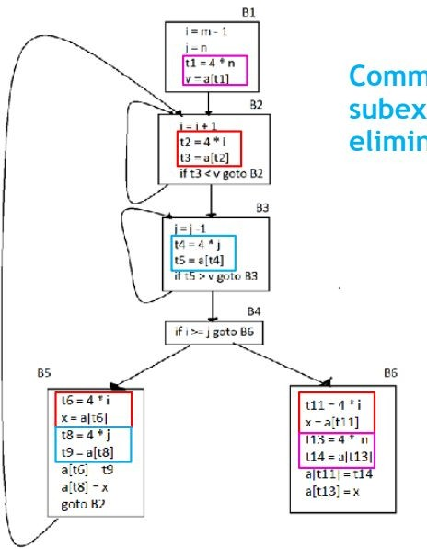
Compiler Design Optimization on CFG
Example 3 contd. Global optimization CSE

Slide 17
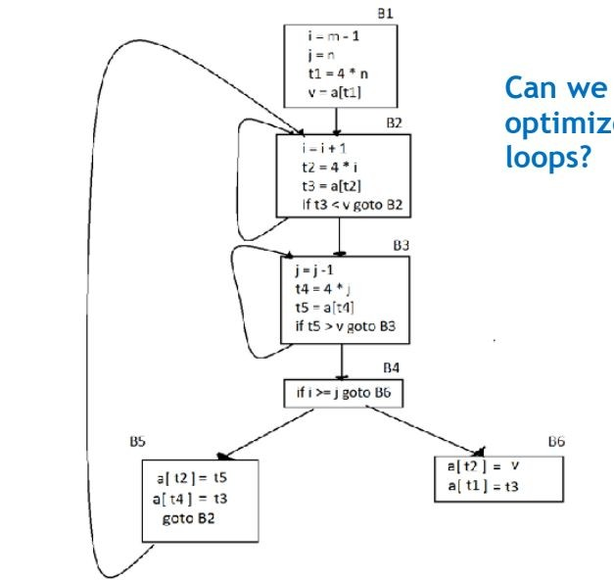
Compiler Design Optimization on CFG
Example 3 contd. Global optimization Can we optimize loops?

Slide 18
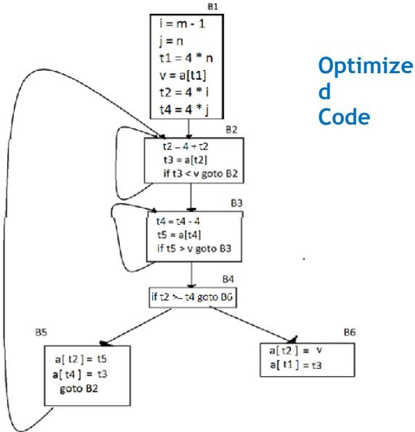
Compiler Design Optimization on CFG
Example 3 contd.
Optimized code

Slide 19
Compiler Design Optimization on CFG
Homework
Convert the following code to CFG using 3AC & optimize the CFG.
for (i = 0, i<n; i++) { for (j=0; j<n; j++){
if (i%2){
P = 10*j + 5*i; Q = 10 + 10*j;
}
}
}

Slide 20
THANK YOU
Preet Kanwal
Department of Computer Science & Engineering
preetkanwal@pes.edu

